Slide 1
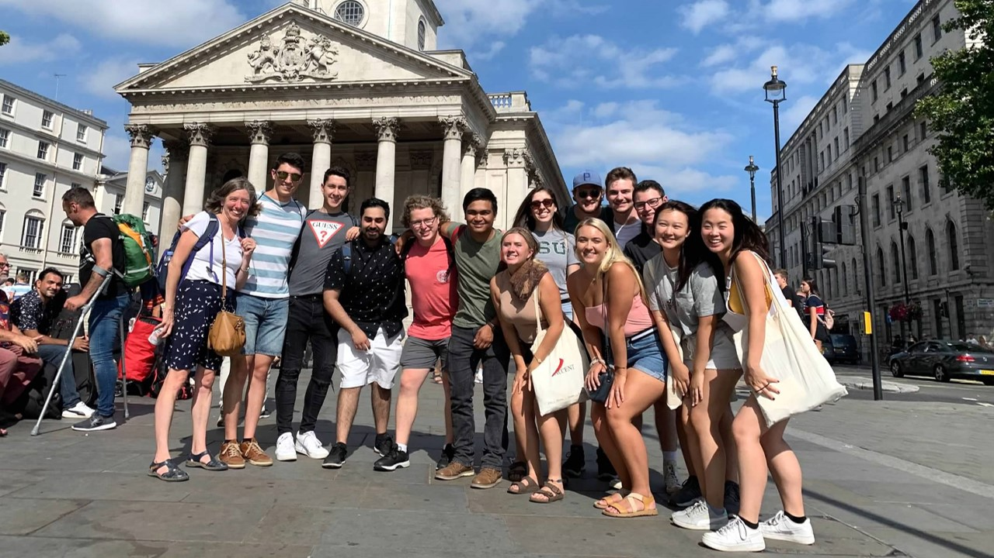
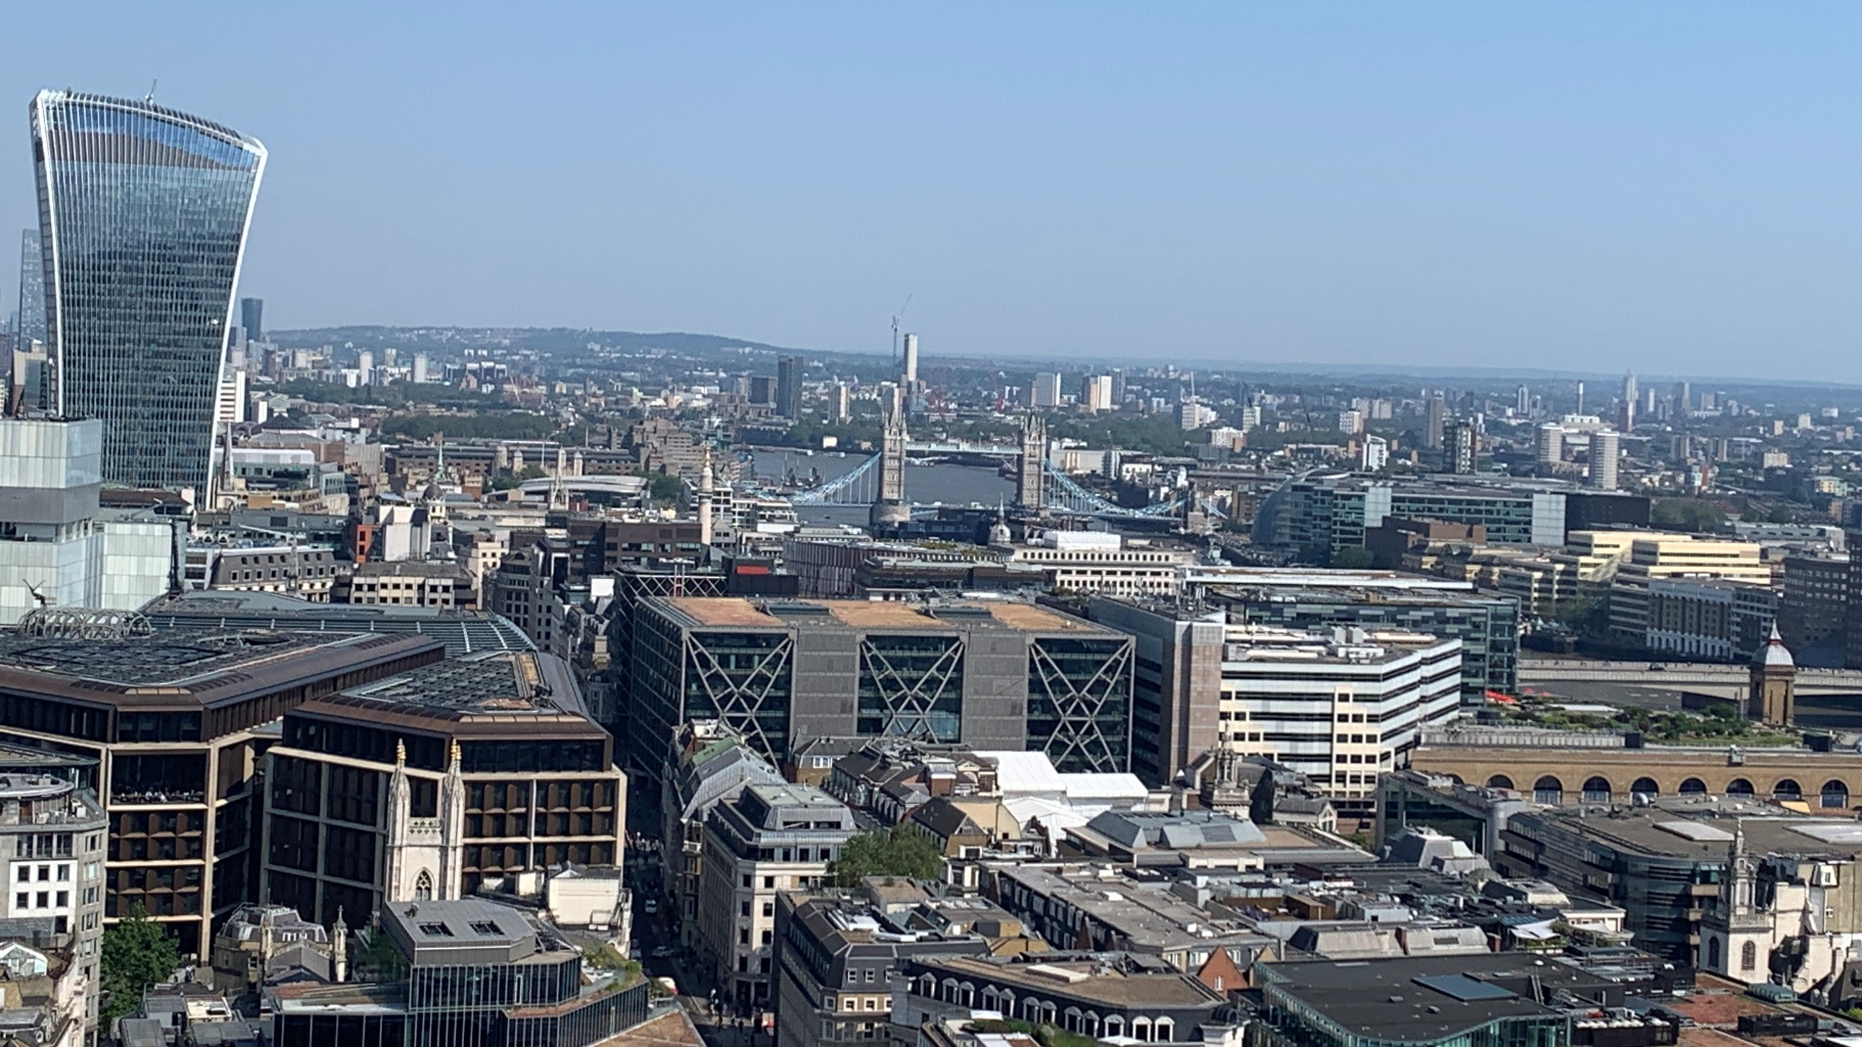

Applied Economics in London Summer 2026
Benefits
EC391 and EC450 credit
Experiential learning credit
Living, exploring & learning in London in small group environment
Learn more
Info Session Jan. 15 at 4:30 pm in the Marshall-Adams Koo Room
Email haider@msu.edu or prabhat@msu.edu

